Slide 1
Zigzag EPI with Sinusoidal Gradient
Magnetic Resonance Imaging sequence programming
Nan Lan

Slide 2
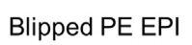


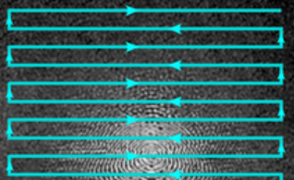
Method—Blipped EPI
Drawback:
noice: round 110-120dB
Reason:
frequent and sharp switch of gradient field
Fig. 1. Blipped Phase Encoding EPI with Sinusoidal Gradient
Source: https://mriquestions.com

Slide 3
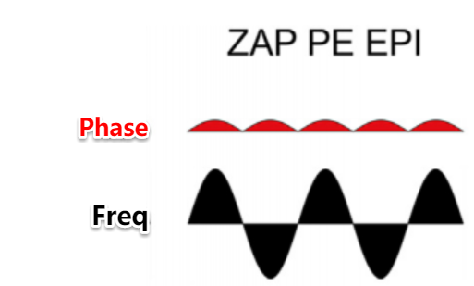
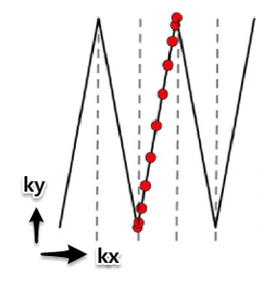
Method—Sin Zigzag EPI
Pros:
quite
Reason:
smooth gradient trajectory due to sin gradient
Fig. 2. Zigzag-Aligned-Projections Phase Encoding EPI with Sinusoidal Gradient [2]

Slide 4
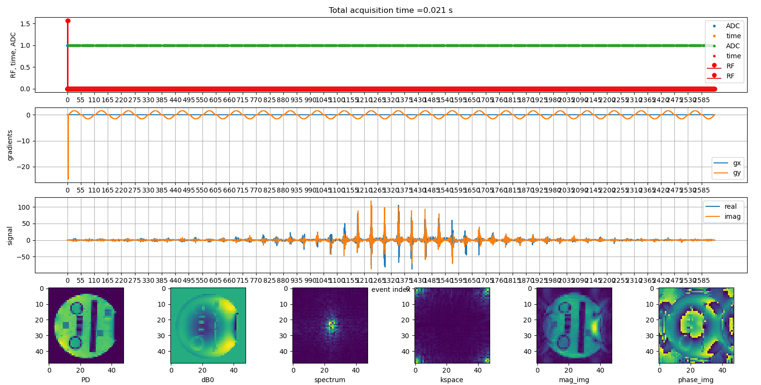
Image Result of Sin Zigzag EPI
Fig. 3.Image Result of Zigzag EPI with Sinusoidal Gradient

Slide 5
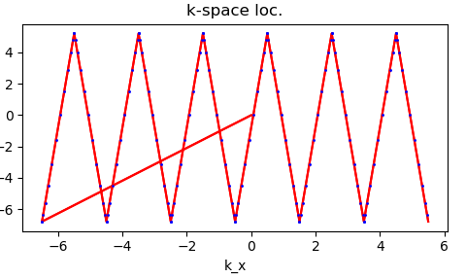
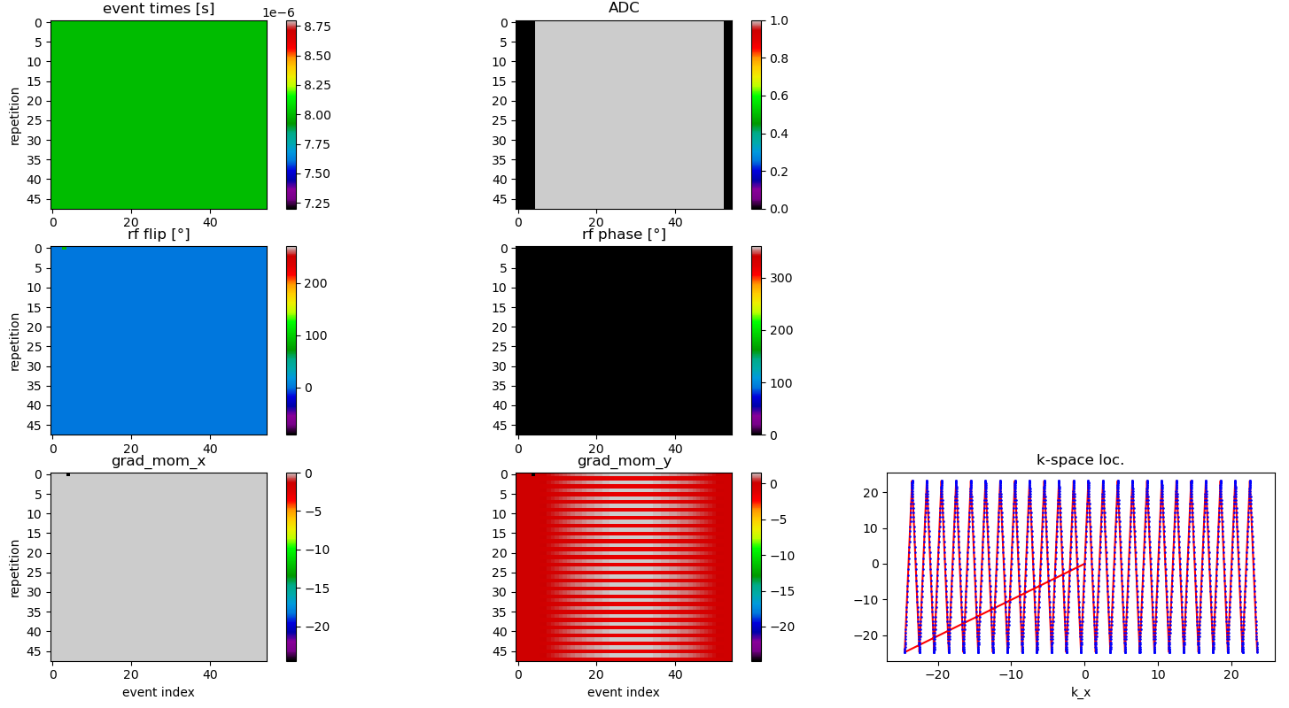
K-space result of Sin Zigzag EPI
Fig. 4.K-space Result of Zigzag EPI with Sinusoidal Gradient

Slide 6
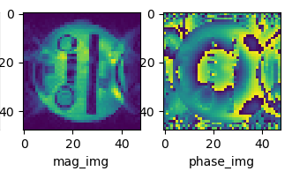
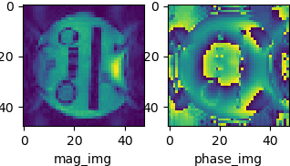
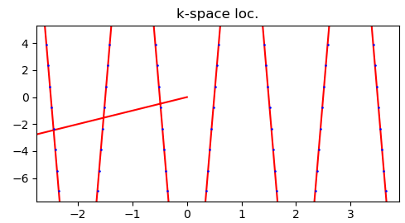
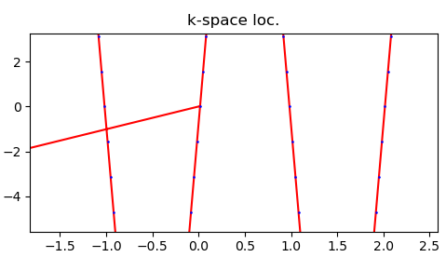
Midpoint correction comparison
Fig. 5. Zigzag EPI with Sinusoidal Gradient without midpoint correction
Fig. 6. Zigzag EPI with Sinusoidal Gradient and midpoint correction
Notes:
Here, I zoom in the kapsce image a bit so that we can clearly see compare them.
After midpoint correction, the reconstruction image becomes better. So we need to adjust the first rewinder in both direction, where the shift can be calculated.
However, this zigzag sequence face challenges for Cartesian parallel imaging techniques. The sequence samples discrete signals sampled at unequal intervals. Therefore, NUFFT is required here.

Slide 7
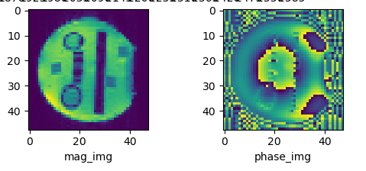
Com. between normal and zigzag sin EPI
Fig. 7. Nnormal EPI without Sinusoidal Gradient
Fig. 6. Zigzag EPI with Sinusoidal Gradient and midpoint correction

Slide 8
Referrence
[2] Patrick Liebig, Robin M. Heidemann, Bernhard Hensel & David A. Porter Accelerated silent echo-planar imaging. ELSEVIER 2019. 55: 81–85.

